Slide 1
UX - QHO428

Slide 2
Introduction to User Experience
UX: QHO428
Dr Abdul Salih
W1, Lect. 21 Feb 2022

Slide 3
Module Learning outcomes
On successful completion of this module, you will be able to
Identify the key component of User Experience context, including understanding the technology and stakeholders.
Interpret digital product or service requirements including business, technical and potential user sources and define appropriate measures of success, including goals, objectives and key performance indicators (KPIs).
Explain issues with usability and effectiveness of digital products and services and to identify areas for improvement.
Describe digital product usability, accessibility and other legal requirements.
Interpret user types and their goals, behaviours and pain points using appropriate design artefacts to inform the design process.

Slide 4
Assessment
Assignment : 100% - Individual written report

Slide 5
Week 1- Objectives
Definition
Interface design models
Design principles
GUI characteristics
User Guidance
Usability Testing

Slide 6
User Interface
User interface (UI) design is the process of making interfaces in software or computerized devices with a focus on looks or style.
Designers aim to create designs users will find easy to use and pleasurable. UI design typically refers to graphical user interfaces

Slide 7
The UI design process
UI design is an iterative process involving close liaisons between users and designers.
The 3 core activities in this process are:
  User analysis. Understand what the users will do with the system;
  System prototyping. Develop a series of prototypes for experiment;
  Interface evaluation. Experiment with these prototypes with users.

Slide 8
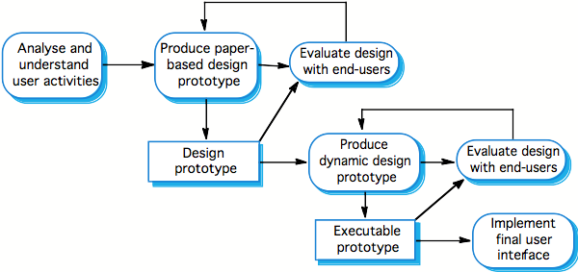
The design process

Slide 9
Interface Design Models
Four different models occur in UX design:
The design model expresses the software design.
The user model describes the profile of the end users. (i.e., novices vs. experts, cultural background, etc.)
The user’s model is the end users’ perception of the system.
The system image is the external manifestation of the system (look and feel + documentation etc.)

Slide 10
UI Models
…
Implementation Model
Mental Model
Implementation Model
Mental Model
Worse
Manifest Models
Better
Alan Cooper, About Face, 1995

Slide 11
UX Design Principles
Principle | Description
Memory load | Reduce the amount of information that must be remembered between actions. Minimize the memory load.
Efficiency | Seek efficiency in dialogue, motion and thought. Minimize keystrokes and mouse movements.
Recoverability | Allow users to recover from their errors. Include undo facilities, confirmation of destructive actions, 'soft' deletes, etc.
User guidance | Incorporate some form of context-sensitive user guidance and assistance.

Slide 12
GUI Characteristics
Characteristic | Description
Windows | Multiple windows allow different information to be displayed simultaneously on the user’s screen.
Icons | Usually icons represent files (including folders and applications), but they may also stand for processes (e.g., printer drivers).
Menus | Menus bundle and organize commands (eliminating the need for a command language).
Pointing | A pointing device such as a mouse is used for command choices from a menu or indicating items of interest in a window.
Graphics | Graphical elements can be commands on the same display.

Slide 13
GUIs
Advantages
They are easy to learn and use.
  Users without experience can learn to use the system quickly.
The user may switch attention between tasks and applications.
Fast, full-screen interaction is possible with immediate access to the entire screen
Problems
A GUI is not automatically a good interface
  Many software systems are never used due to poor UI design
  A poorly designed UI can cause a user to make catastrophic errors

Slide 14
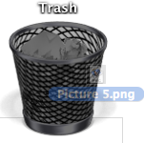
Direct Manipulation
Advantages
Users feel in control and are less likely to be intimidated by the system
User learning time is relatively short
Users get immediate feedback on their actions
mistakes can be quickly detected and corrected
Problems
Finding the right user metaphor may be difficult
It can be hard to navigate efficiently in a large information space.
It can be complex to program and demanding to execute

Slide 15
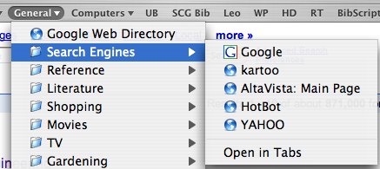
Menu Systems
Advantages
Users don’t need to remember command names
Typing effort is minimal
User errors are trapped by the interface
Context-dependent help can be provided (based on the current menu selection)
Problems
Actions involving logical conjunction (and) or disjunction (or) are awkward to represent
If there are many choices, some menu structuring facility must be used
Experienced users find menus slower than command language

Slide 16
Menu Structuring
Scrolling menus
The menu can be scrolled to reveal additional choices
Not practical if there is a very large number of choices
Hierarchical menus
Selecting a menu item causes the menu to be replaced by a sub-menu
Walking menus
A menu selection causes another menu to be revealed
Associated control panels
When a menu item is selected, a control panel pops-up with further options

Slide 17
Command Interfaces
With a command language, the user types commands to give instructions to the system
May be implemented using cheap terminals
Easy to process using compiler techniques
Commands of arbitrary complexity can be created by command combination
Concise interfaces requiring minimal typing can be created

Slide 18
Command Interfaces
Advantages
Allow experienced users to interact quickly with the system
Commands can be scripted (!)
Problems
Users have to learn and remember a command language
Not suitable for occasional or inexperienced users
An error detection and recovery system is required
Typing ability is required (!)

Slide 19
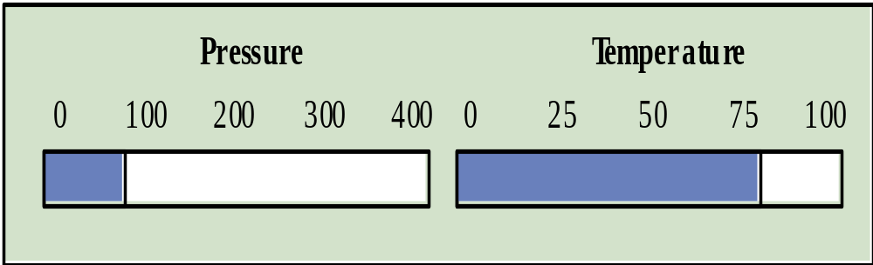
Analogue vs. Digital Presentation
Digital presentation
Compact — takes up little screen space
Precise values can be communicated
Analogue presentation
Easier to get an 'at a glance' impression of a value
Possible to show relative values
Easier to see exceptional data values
Notes:
Ch 15

Slide 20
Colour Use Guidelines
Colour can help the user understand complex information structures.
Don’t use (only) colour to communicate meaning!
  Open to misinterpretation (colour-blindness, cultural differences ...)
  Design for monochrome then add colour
Use colour coding to support user tasks
  highlight exceptional events
  allow users to control colour coding
Use colour change to show status change
Don't use too many colours
  Avoid colour pairings which clash
Use colour coding consistently
which clash

Slide 21
User Guidance
The user guidance system is integrated with the user interface
to help users when they need information about the system
or when they make some kind of error.
Includes
System messages, including error messages
Documentation provided for users
On-line help

Slide 22

Help system use
Multiple entry points should be provided
  the user should be able to get help from different places
The help system should indicate where the user is positioned
Navigation and traversal facilities must be provided

Slide 23
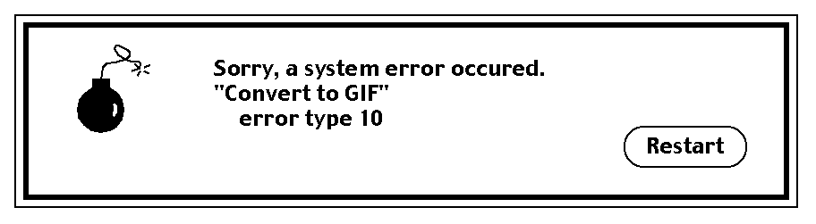
Error Message Guidelines
Speak the user’s language
Give constructive advice for recovering from the error
Indicate negative consequences of the error (e.g., possibly corrupted files)
Give an audible or visual cue
Don’t make the user feel guilty!
Notes:
Pressman p 471

Slide 24
Usability Testing
Observe a group of test subjects performing a pre-defined scenario
  Which test subjects?
  How many test subjects?
  Which scenarios?
  What to observe?

Slide 25
User interface evaluation
Some evaluation of a user interface design
should be carried out to assess its usability.
Full scale evaluation is very expensive and
impractical for most systems.
Ideally, an interface should be evaluated against a usability specification. However, it is rare for such specifications to be produced.

Slide 26
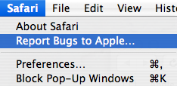
Simple evaluation techniques
Questionnaires for user feedback.
Video recording of system use and subsequent tape evaluation.
Instrumentation of code to collect information about facility use and user errors.
The provision of code in the software to collect on-line user feedback.

Slide 27
Hints
Establish concrete goals — what do you want to achieve?
  What criteria will you use to establish “success”?
  What data will you collect?
  Choose representative test tasks.
Carry out a pilot test first.
Test users should truly represent the intended users.
Use experienced experimenters. (Get trained!)
  Make the test subjects feel comfortable.
  Don’t bias the results.

Slide 28
Usability Attributes
Attribute | Description
Learnability | How long does it take a new user to become productive with the system?
Speed of operation | How well does the system response match the user’s work practice?
Robustness | How tolerant is the system of user error?
Recoverability | How good is the system at recovering from user errors?
Adaptability | How closely is the system tied to a single model of work?

Slide 29
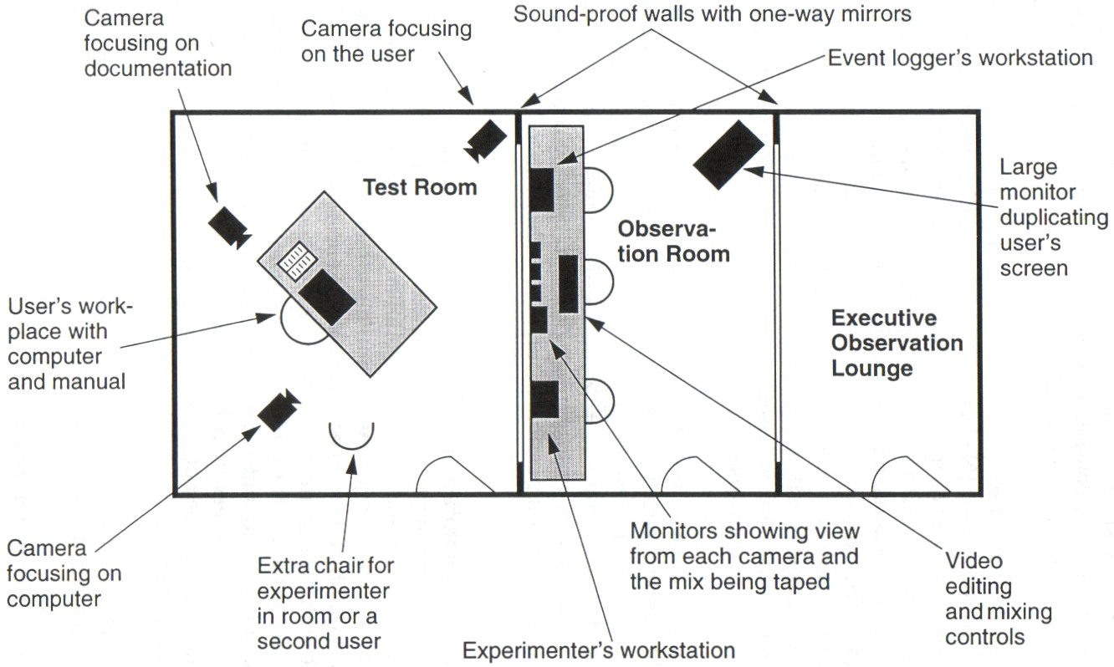
Usability laboratories (!)

Slide 30
Summary
The user interface design process involves user analysis, system prototyping and prototype evaluation.
User interface design principles should help guide the design of user interfaces.
Interaction styles include direct manipulation, menu systems form fill-in, command languages and natural language.
Graphical displays should be used to present trends and approximate values. Digital displays when precision is required.
Colour should be used sparingly and consistently.
The goals of UI evaluation are to obtain feedback on how to improve the interface design and to assess if the interface meets its usability requirements.

Slide 31
What you should know
What models are important to keep in mind in UI design?
What is the principle of minimal surprise?
What problems arise in designing a good direct manipulation interface?
What are the trade-offs between menu systems and command languages?
How can you use colour to improve a UI?
In what way can a help system be context sensitive?

Slide 32
Recommended Books
Unger, R. and Chandler, C., 2012. A project guide to UX design. Berkeley, Calif: New Riders.
Garrett, J., 2011. The elements of user experience. Berkeley, CA: New Riders.

